Slide 1

Retail Sales
Review
By Mayowa Adeboye

Slide 2

Project Background
Objective: Identify high-margin products, high-value customers, and peak operational windows.
Scope: Analysis of 1,987 verified records across Clothing, Beauty, and Electronics categories.

Slide 3

Executive Summary
Financial Health: The business maintains an excellent 79.20% profit margin, with a total profit of $719,302.
Top Performer: Clothing is the top profit-driving category ($245,945), closely followed by Electronics.
Demographic Focus: Sales are strongest among Adults (30-50), with Female shoppers in this bracket being the highest spenders.
Operational Peak: Revenue peaks in December and during the 7:00 PM (19:00) hour.

Slide 4

Data Overview
Removed 13 incomplete records to ensure 100% accurate profit calculations.
Unified naming for categories (e.g., "Clo" to "Clothing") and genders to prevent split reporting.
1,987 cleaned records.
Implemented aggregations, Case statements for "Bulk vs. Small" analysis, and Date formatting.

Slide 5
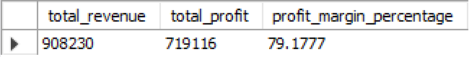
Profitability (P1)
Total Revenue of $908,230 with a Cost of Goods Sold (COGS) of $188,927, resulting in $719,302 net profit.

Slide 6
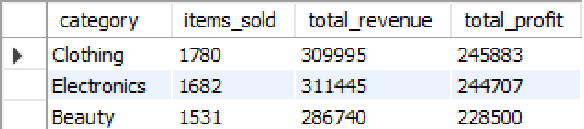
Category Strategy (P2)
Clothing: $245,945 profit.
Electronics: $244,767 profit.
Beauty: $228,589 profit.
Investment should be balanced as all three categories show high profitability, but Clothing has the highest volume.

Slide 7
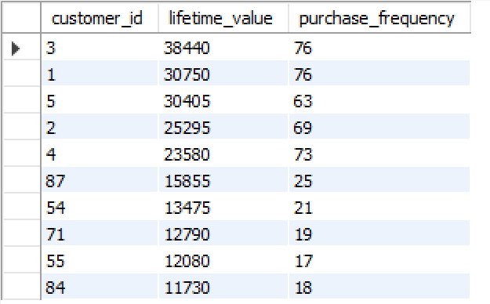
High-Value Customers(P3)
Customer ID 3 is the top "whale" with $38,440 in spend.
Customer ID 1 ($30,750) and ID 5 ($30,405) follow.
These top 10 customers drive a disproportionate amount of revenue and should be prioritized for loyalty rewards.

Slide 8
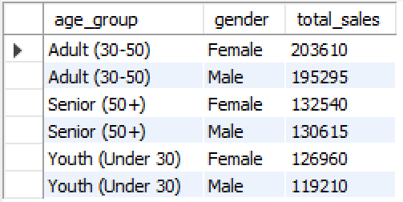
Demographic Influence(P4)
Adults (30-50) are the dominant segment, contributing over $379,000 in revenue.
Female shoppers spend slightly more than males across almost every age bracket.

Slide 9
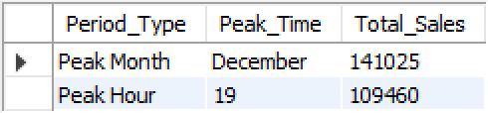
Operational Trends(P5)
Peak Month: December ($141,025).
Peak Hour: 7:00 PM (19:00) ($109,460).

Slide 10
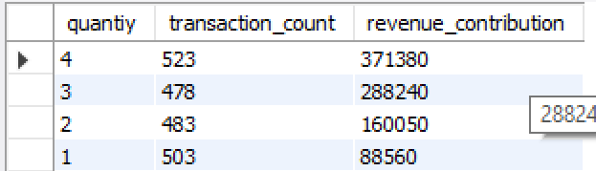
Transactional Behavior(P6)
Transactions are almost perfectly split between 1, 2, 3, and 4 items.
However, Bulk orders (3-4 items) contribute $659,620 (72% of revenue) compared to only $248,610 from small orders

Slide 11

Recommendations
Target females aged 30-50 with "Bundle Deals" to increase transaction size.
Maximize staff coverage between 6:00 PM and 8:00 PM to handle the daily evening rush
.
Aggressively stock Clothing and Electronics inventory in late Q4 to prepare for the December peak.

Slide 12

Thank you!

